Slide 1




LEARN IT
FOR TECHNOLOGICAL EDUCATION

Slide 2

Back-End ASP.Net BootCamp

Slide 3
Session 3 . C#

Slide 4
Contents of the presentation
Value vs Reference Types
Pass by value & ref

Slide 5
Contents of the presentation
Implicit and Explicit Conversion
Built-in Collections
IEnumerator and IEnumerable

Slide 6
Value vs Reference Types
In C#, types are categorized into two broad categories: Value Types and Reference Types. Understanding the distinction between these types is crucial for efficient memory management, performance optimization, and avoiding bugs in your code.

Slide 7
Value vs Reference Types
1. Value Types
Value types hold data directly in the memory location where the variable is declared. When a value type is assigned to another variable, a copy of the value is created.

Slide 8
Value vs Reference Types
Key Characteristics:
Stored in Stack Memory: Value types are typically stored in the stack. However, if they are part of an object (e.g., in a class), they may be stored on the heap as part of the object.
Copy by Value: When you assign a value type variable to another variable, a new copy of the value is created.
No Shared Memory: Each variable holds its own copy of the data. Modifying one does not affect the other.
Examples of Value Types: Primitive types (like int, float, bool, char), struct, enum.

Slide 9
Value vs Reference Types
int x = 10;
int y = x; // y is a copy of x
y = 20; // Changing y does not affect x
Console.WriteLine(x); // Outputs: 10
Console.WriteLine(y); // Outputs: 20
In the example above, x and y are two separate variables with distinct memory locations. Modifying y doesn't change the value of x because y was a copy of x when it was assigned.

Slide 10
Value vs Reference Types
Common Value Types:
int
float
double
bool
char
struct (a custom value type)
enum

Slide 11
Value vs Reference Types
2. Reference Types
Reference types store references to the memory location where the actual data is held. When a reference type is assigned to another variable, the reference (or address) to the same memory location is copied, not the actual value. Therefore, both variables refer to the same data, and modifying one will affect the other.

Slide 12
Value vs Reference Types
Key Characteristics:
Stored in Heap Memory: Reference types are stored in the heap memory, and the variable itself (which is the reference to the object) is stored in the stack.
Copy by Reference: When you assign a reference type variable to another variable, both variables refer to the same memory location (they point to the same object).
Shared Memory: Both variables refer to the same object, so changes to one affect the other.
Examples of Reference Types: Classes, Arrays, Strings, Delegates, Interfaces, and dynamic types.

Slide 13
Value vs Reference Types
class Person
{
public string Name;
}
Person p1 = new Person();
p1.Name = "John";
Person p2 = p1; // p2 refers to the same Person object as p1
p2.Name = "Jane"; // Modifies the same object that p1 refers to
Console.WriteLine(p1.Name); // Outputs: Jane
Console.WriteLine(p2.Name); // Outputs: Jane
In this case, both p1 and p2 point to the same Person object in memory. Changing p2.Name also changes p1.Name because they both reference the same object.

Slide 14
Value vs Reference Types
Common Reference Types:
class
string (strings in C# are immutable reference types)
array
delegate
interface
dynamic
object (base class for all types in C#)

Slide 15
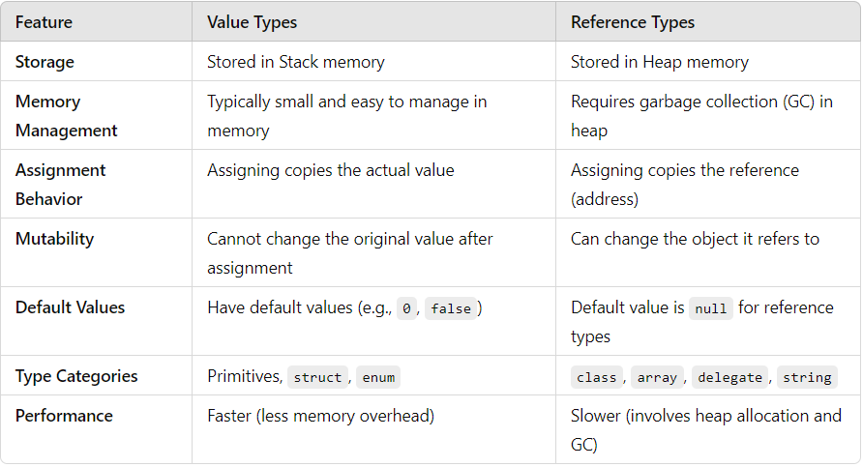
Value vs Reference Types
Differences Between Value Types and Reference Types

Slide 16
Pass by value & ref
In C#, when passing parameters to methods, you can pass them either by value or by reference. Understanding the differences between these two modes is crucial for controlling how data is manipulated and ensuring efficient memory use. Let’s break down the concepts of pass by value and pass by reference in detail.

Slide 17
Pass by value & ref
1. Pass by Value
By default, C# passes method parameters by value. This means that a copy of the original variable is passed to the method, and any changes made to the parameter inside the method do not affect the original variable outside the method.

Slide 18
Pass by value & ref
Key Characteristics:
A copy of the value is passed: When you pass a variable by value, the method receives a copy of the variable, so any modifications inside the method will not affect the original variable.
Used with value types: For value types like int, float, bool, and struct, the actual value is copied.
Used with reference types (by default): For reference types (like class, string, array), the reference (memory address) is passed by value, but since the reference points to the same object, changes to the object inside the method will affect the object, not the reference itself.

Slide 19
Pass by value & ref
using System;
class Program
{
static void Main()
{
int a = 5;
Console.WriteLine("Before method call: " + a); // Outputs: 5
ModifyValue(a); // Passing by value
Console.WriteLine("After method call: " + a); // Outputs: 5 (no change)
}
static void ModifyValue(int x)
{
x = 10; // Modifying the copy
}
}
Result: The value of a remains 5 after the method call because the method only modified a copy of a, not the original variable

Slide 20
Pass by value & ref
using System;
class Program
{
static void Main()
{
string str = "Hello";
Console.WriteLine("Before method call: " + str); // Outputs: Hello
ModifyString(str); // Passing by value (the reference is passed by value)
Console.WriteLine("After method call: " + str); // Outputs: Hello (no change)
}
static void ModifyString(string s)
{
s = "Goodbye"; // Reassigning the reference, but it does not affect the original variable
}
}
Result: The original string str remains unchanged after the method call because reassigning the parameter s inside the method does not affect the original reference.

Slide 21
Pass by value & ref
using System;
class Program
{
class Person
{
public string Name;
}
static void Main()
{
Person p = new Person() { Name = "Alice" };
Console.WriteLine("Before method: " + p.Name); // Output: Alice
ModifyPerson(p);
Console.WriteLine("After method: " + p.Name); // Output: Bob
}
static void ModifyPerson(Person person)
{
person.Name = "Bob"; // This changes the name of the object
person = new Person() { Name = "Charlie" }; // This changes the reference, but does not affect the original
}
}

Slide 22
Pass by value & ref
Explanation:
The Person p object is passed to ModifyPerson. Inside ModifyPerson, the person parameter is a copy of the reference to the same Person object.
When person.Name = "Bob" is executed, the name of the object that p points to is changed.
But when person = new Person() is executed, it changes the local reference to point to a new Person object. This does not affect the original p reference outside the method.
So, while the reference is passed by value, the object it refers to can be modified within the method.

Slide 23
Pass by value & ref
2. Pass by Reference (ref)
In C#, the ref keyword is used to pass parameters by reference. This means that the method receives a reference to the original variable, not a copy, so changes made to the parameter inside the method will affect the original variable.

Slide 24
Pass by value & ref
Key Characteristics:
Pass by reference: The ref keyword allows you to pass a variable by reference. Any modifications to the parameter inside the method will reflect on the original variable outside the method.
Requires initialization: The variable passed to a method using ref must be initialized before it is passed to the method.
Both value types and reference types can be passed by reference.
void MethodName(ref Type parameterName) { }

Slide 25
Pass by value & ref
using System;
class Program
{
static void Main()
{
int a = 5;
Console.WriteLine("Before method call: " + a); // Outputs: 5
ModifyValueByRef(ref a); // Passing by reference
Console.WriteLine("After method call: " + a); // Outputs: 10 (value changed)
}
static void ModifyValueByRef(ref int x)
{
x = 10; // Modifies the original variable
}
}
Result: The value of a is changed to 10 after the method call because the parameter is passed by reference, so changes inside the method directly affect the original variable.

Slide 26
Pass by value & ref
using System;
class Program
{
static void Main()
{
string str = "Hello";
Console.WriteLine("Before method call: " + str); // Outputs: Hello
ModifyStringByRef(ref str); // Passing by reference
Console.WriteLine("After method call: " + str); // Outputs: Goodbye
}
static void ModifyStringByRef(ref string s)
{
s = "Goodbye"; // Changes the reference to point to a new string
}
}
Result: The original string str is changed to "Goodbye" after the method call because the parameter s is passed by reference, so the modification to s affects the original string.

Slide 27
Pass by value & ref
3. Pass by Output (out)
The out keyword is another way to pass parameters by reference. The key difference from ref is that variables passed using out do not need to be initialized before being passed to the method. The method must assign a value to the out parameter before it returns, ensuring that the variable is initialized within the method.

Slide 28
Pass by value & ref
Key Characteristics:
No need for initialization: The variable passed with out doesn’t need to be initialized before passing it to the method.
Method must assign a value: The method is required to assign a value to the out parameter before the method finishes execution.
void MethodName(out Type parameterName) { }

Slide 29
Pass by value & ref
using System;
class Program
{
static void Main()
{
int result;
AddNumbers(10, 20, out result); // Using 'out'
Console.WriteLine("The result is: " + result); // Outputs: The result is: 30
}
static void AddNumbers(int a, int b, out int sum)
{
sum = a + b; // Must assign a value to the 'out' parameter
}
}
Result: The out parameter result is not initialized before the method call, but inside the method, it is assigned a value (30), and that value is passed back to the caller.

Slide 30
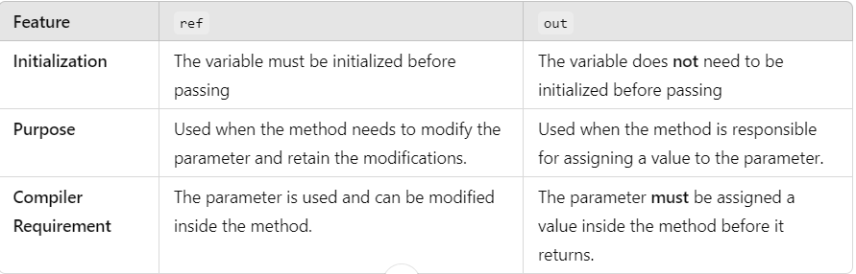
Pass by value & ref
4. Differences Between ref and out
While both ref and out pass parameters by reference, there are some important differences between them:

Slide 31
Pass by value & ref
5. Pass by (in) parameter
Purpose: The in keyword is used to pass an argument by reference without allowing the method to modify the argument. The method can read the value but cannot change it.
Requirement: The variable being passed to the method must be initialized beforehand, but the method cannot modify the value of the parameter.
Typical Use Case: When you want to pass a large object or value type (like a struct) to a method for performance reasons but don't want the method to alter the data.

Slide 32
Pass by value & ref
using System;
class Program
{
static void Main()
{
int num = 10;
DisplayValue(in num);
Console.WriteLine(num); // Output: 10 (unchanged)
}
static void DisplayValue(in int number)
{
Console.WriteLine(number); // Output: 10
// number = 20; // Error: Cannot modify an 'in' parameter
}
}
Key point: The in parameter allows the method to read the number but prevents it from modifying the value. It's useful for passing large structs efficiently because it avoids copying the entire value but prevents modifications.

Slide 33
Implicit and Explicit Conversion Built-in Collections
In C#, implicit and explicit conversions refer to the ways in which the language handles type conversion between different types (both primitive and custom types). Additionally, C# provides a wide range of built-in collections to manage groups of data. Let's explore these topics in detail.

Slide 34
Implicit and Explicit Conversion Built-in Collections
1. Implicit and Explicit Conversion in C#:
Implicit Conversion (Automatic Type Conversion)
Implicit conversion occurs when the C# compiler automatically converts one type to another without the need for explicit instructions from the developer. This is usually done when converting a smaller or more specific type to a larger or more general type, where there is no risk of data loss.

Slide 35
Implicit and Explicit Conversion Built-in Collections
Key Points:
No data loss: The conversion is performed automatically because the compiler knows there will be no data loss.
Safe conversions: These are conversions that do not lose precision or require extra handling.

Slide 36
Implicit and Explicit Conversion Built-in Collections
using System;
class Program
{
static void Main()
{
int intValue = 123;
double doubleValue = intValue; // Implicit conversion: int to double
Console.WriteLine(doubleValue); // Outputs: 123
}
}
The integer int (a 32-bit value) is implicitly converted to a double (a 64-bit value) without any data loss. Since double can hold any integer value, this conversion is safe and automatic.

Slide 37
Implicit and Explicit Conversion Built-in Collections
Common Implicit Conversions:
Numeric types: int to long, long to float, float to double, char to int, etc.
char cha = 'a';
int intV = cha;
Console.WriteLine(intV); // Outputs: 97 ASCII Code of 'a'
Reference types: Subtypes can be implicitly converted to their base type. For example, a Dog object can be implicitly converted to an Animal type if Dog inherits from Animal.

Slide 38
Implicit and Explicit Conversion Built-in Collections
class Animal { }
class Dog : Animal { }
class Program
{
static void Main()
{
Dog dog = new Dog();
Animal animal = dog; // Implicit conversion from Dog to Animal
Console.WriteLine(animal.GetType().Name); // Outputs: Dog
}
}
In this case, Dog is implicitly converted to Animal because Dog inherits from Animal.

Slide 39
Implicit and Explicit Conversion Built-in Collections
2. Explicit Conversion (Casting)
Explicit conversion, or casting, occurs when the developer needs to tell the compiler how to convert a type. This is necessary when converting from a larger or more general type to a smaller or more specific type, where there might be a risk of data loss.

Slide 40
Implicit and Explicit Conversion Built-in Collections
Key Points:
Potential data loss: Explicit conversions may result in loss of precision or data, and the compiler requires you to confirm the conversion.
Requires the use of a cast: A cast is written as (TargetType)variable, explicitly indicating the desired conversion.

Slide 41
Implicit and Explicit Conversion Built-in Collections
using System;
class Program
{
static void Main()
{
double pi = 3.14159;
int piInt = (int)pi; // Explicit conversion: double to int (data loss)
Console.WriteLine(piInt); // Outputs: 3 (decimal part is truncated)
}
}
We explicitly cast double to int. The fractional part (.14159) is discarded during the conversion, and the result is 3.

Slide 42
Implicit and Explicit Conversion Built-in Collections
class Animal { }
class Dog : Animal { }
class Program
{
static void Main()
{
Animal animal = new Dog(); // Implicit conversion from Dog to Animal
Dog dog = (Dog)animal; // Explicit cast from Animal to Dog
Console.WriteLine(dog.GetType().Name); // Outputs: Dog
}
}
First, a Dog object is implicitly cast to an Animal type.
Then, an explicit cast is used to convert it back to Dog. This works fine as long as animal is indeed a Dog object. If animal were not a Dog, a runtime exception (InvalidCastException) would occur.

Slide 43
Implicit and Explicit Conversion Built-in Collections
Built-in Collections in C#
C# provides several built-in collection types that help manage groups of objects. Collections in C# are part of the System.Collections namespace and are used to store, retrieve, and manipulate data efficiently. The most common built-in collections are arrays, lists, dictionaries, queues, stacks, and others. Let's explore the most commonly used ones.

Slide 44
Implicit and Explicit Conversion Built-in Collections
1. Arrays
An array is a fixed-size collection of elements of the same type. Arrays are indexed and provide fast access to elements.
int[] numbers = new int[5]; // Create an array of integers with 5 elements
numbers[0] = 10;
numbers[1] = 20;
Console.WriteLine(numbers[0]); // Outputs: 10
Console.WriteLine(numbers.Length); // Outputs: 5 (length of the array)
- Fixed size: The size of the array is determined when it is created and cannot be changed later.
- Efficient access: Arrays provide O(1) access time for elements based on index.

Slide 45
Implicit and Explicit Conversion Built-in Collections
2. List<T>
A List<T> is a generic collection that dynamically resizes. It can hold elements of any specified type and provides a more flexible alternative to arrays.
List<int> numbers = new List<int>();
numbers.Add(10);
numbers.Add(20);
numbers.Add(30);
Console.WriteLine(numbers[1]); // Outputs: 20
Console.WriteLine(numbers.Count); // Outputs: 3 (size of the list)
Dynamic resizing: Unlike arrays, List<T> can grow or shrink in size as needed.
Generic: You can define a List for any type, making it type-safe.
Common methods: .Add(), .Remove(), .Contains(), .Insert(), .Sort().

Slide 46
Implicit and Explicit Conversion Built-in Collections
3. Dictionary<TKey, TValue>
A Dictionary<TKey, TValue> is a collection of key-value pairs, where each key is unique. It provides fast lookup for values based on keys.
Dictionary<string, int> ages = new Dictionary<string, int>();
ages.Add("Alice", 25);
ages.Add("Bob", 30);
Console.WriteLine(ages["Alice"]); // Outputs: 25
Key-value pairs: The dictionary stores values that are indexed by unique keys.
Fast lookup: Provides average O(1) time complexity for lookups, inserts, and deletions.
Generic: Type-safe, so you can define a dictionary for any combination of key and value types.

Slide 47
Implicit and Explicit Conversion Built-in Collections
4. Queue<T>
A Queue<T> is a first-in, first-out (FIFO) collection. It allows you to add elements at the end and remove elements from the front.
Queue<string> queue = new Queue<string>();
queue.Enqueue("First");
queue.Enqueue("Second");
queue.Enqueue("Third");
Console.WriteLine(queue.Dequeue()); // Outputs: First
Console.WriteLine(queue.Peek()); // Outputs: Second (next in line)
FIFO order: The first element added is the first one to be removed.
Common methods: .Enqueue(), .Dequeue(), .Peek().

Slide 48
Implicit and Explicit Conversion Built-in Collections
5. Stack<T>
A Stack<T> is a last-in, first-out (LIFO) collection. You add elements to the top of the stack and remove them from the top as well.
Stack<string> stack = new Stack<string>();
stack.Push("First");
stack.Push("Second");
stack.Push("Third");
Console.WriteLine(stack.Pop()); // Outputs: Third
Console.WriteLine(stack.Peek()); // Outputs: Second (top of the stack)
LIFO order: The last element added is the first one to be removed.
Common methods: .Push(), .Pop(), .Peek().

Slide 49
Implicit and Explicit Conversion Built-in Collections
6. HashSet<T>
A HashSet<T> is a collection of unique elements. It does not maintain the order of elements and is optimized for fast lookups.
HashSet<int> numbers = new HashSet<int>();
numbers.Add(10);
numbers.Add(20);
numbers.Add(10); // Duplicate, not added
Console.WriteLine(numbers.Count); // Outputs: 2 (only unique elements are stored)
Unique elements: It only allows unique elements, so duplicates are not stored.
Common methods: .Add(), .Remove(), .Contains().

Slide 50
Implicit and Explicit Conversion Built-in Collections
7. SortedList<TKey, TValue>
A SortedList<TKey, TValue> is a collection of key-value pairs that maintains the elements in sorted order according to the key.
SortedList<int, string> list = new SortedList<int, string>();
list.Add(2, "Two");
list.Add(1, "One");
list.Add(3, "Three");
foreach (var item in list)
{
Console.WriteLine($"{item.Key}: {item.Value}");
}
Sorted by keys: The keys are automatically sorted in ascending order (or descending if specified). From smaller to greater
Common methods: .Add(), .Remove(), .ContainsKey(), .Keys.

Slide 51
IEnumerator and IEnumerable
In C#, IEnumerator and IEnumerable are key interfaces that support the iteration of collections (like arrays, lists, or custom collections) in a standardized way. They are part of the .NET framework and are used to enable the "foreach" loop, allowing you to iterate through elements of a collection without needing to know the internal details of the collection's structure.

Slide 52
IEnumerator and IEnumerable
1. IEnumerable Interface
The IEnumerable interface is the foundation for collections that can be enumerated (iterated) in C#. It defines a single method GetEnumerator() that returns an IEnumerator object, which is used to actually iterate over the collection.
public interface IEnumerable
{
IEnumerator GetEnumerator();
}

Slide 53
IEnumerator and IEnumerable
Key Points:
It is implemented by all collections that can be iterated over, such as arrays, lists, dictionaries, and more.
The GetEnumerator() method returns an IEnumerator object, which is responsible for tracking the state of the iteration.
When you use a foreach loop in C#, the compiler internally calls the GetEnumerator() method to obtain the enumerator object and then calls methods on the enumerator (like MoveNext() and Current) to move through the collection.

Slide 54
IEnumerator and IEnumerable
public class MyCollection : IEnumerable
{
private int[] numbers = { 1, 2, 3, 4, 5 };
public IEnumerator GetEnumerator()
{
return new MyEnumerator(numbers);
}
}

Slide 55
IEnumerator and IEnumerable
2. IEnumerator Interface
The IEnumerator interface is used by the foreach loop to track the current position of the iteration over a collection. It defines methods and properties that allow the enumerator to move through the collection and access the current element.
public interface IEnumerator
{
bool MoveNext();
void Reset();
object Current { get; }
}

Slide 56
IEnumerator and IEnumerable
Key Points:
MoveNext() advances the enumerator to the next element in the collection. It returns true if the next element is available, or false if the end of the collection is reached.
Reset() sets the enumerator back to its initial position (before the first element). This is rarely used in most common implementations and often not supported in modern collections.
Current gets the element at the current position of the enumerator. It returns the object at the current index, and its type is object (but it is often cast to the specific type of the collection).

Slide 57
IEnumerator and IEnumerable
public class MyEnumerator : IEnumerator
{
private int[] numbers;
private int position = -1;
public MyEnumerator(int[] numbers)
{
this.numbers = numbers;
}
public bool MoveNext()
{
position++;
return position < numbers.Length;
}
public void Reset()
{
position = -1;
}
public object Current => numbers[position];
}

Slide 58
IEnumerator and IEnumerable
Important Differences Between IEnumerator and IEnumerable:
1- Role:
- IEnumerable is used to define the collection that can be enumerated.
- IEnumerator is used to actually iterate through the collection and track the current position during iteration.
2- Usage:
- A class implementing IEnumerable is the collection itself (e.g., List<int>, Array, etc.).
- A class implementing IEnumerator is the enumerator object that moves through the collection (e.g., ListEnumerator, ArrayEnumerator, etc.).
3- Methods and Properties:
- IEnumerable only exposes the GetEnumerator() method.
- IEnumerator exposes three members: MoveNext(), Reset(), and Current.

Slide 59
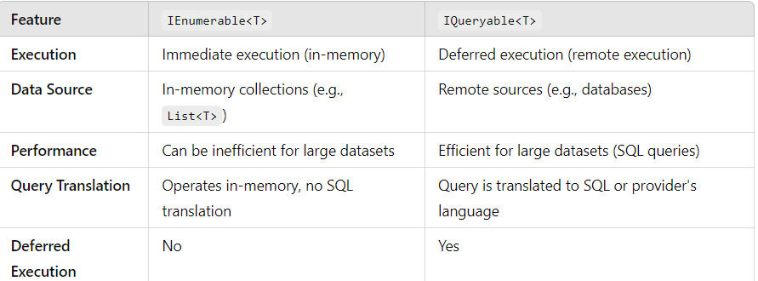
IEnumerable<T> vs IQueryable<T>
Important Differences Between IEnumerable<T> vs IQueryable<T>:
Use IEnumerable<T> when you are working with in-memory collections and want to perform operations directly on them.
Use IQueryable<T> when you are working with an external data source (like a database) and need to leverage deferred execution to avoid loading unnecessary data into memory.

Slide 60
IEnumerable<T> vs IQueryable<T>
IEnumerable<T> (in-memory operation):
List<int> numbers = new List<int> { 1, 2, 3, 4, 5 };
IEnumerable<int> query = numbers.Where(n => n > 3); // query is executed immediately when enumerated
foreach (var num in query)
{
Console.WriteLine(num); // executes immediately and retrieves data in-memory
}
IQueryable<T> (querying a database via Entity Framework):
IQueryable<int> query = dbContext.Numbers.Where(n => n > 3); // query is not executed until you enumerate
//var result = query.ToList(); // The SQL query is sent to the database here
foreach (var num in query)
{
Console.WriteLine(num); // query is executed on the database at this point, not in-memory
}

Slide 61
Challenge 1: Implement IEnumerable with a Custom Collection
Objective:
Create a custom collection class that implements the IEnumerable and IEnumerator interfaces. The class should represent a collection of Person objects, each having properties like Name and Age. Implement the ability to iterate through the collection using foreach.
Requirements:
1- Create a Person class with properties Name (string) and Age (int).
2- Create a PersonCollection class that implements IEnumerable<Person>:
- It should contain a list of Person objects.
- Implement the GetEnumerator() method, which returns an IEnumerator<Person>.
3- Implement the IEnumerator<Person> to iterate over the collection:
- The MoveNext() method should move to the next person in the list.
- The Current property should return the current Person object.
- Implement the foreach loop to iterate through your collection.

Slide 62
Challenge 2: Implicit and Explicit Conversion in C#
Objective:
The goal of this assignment is to create a program that demonstrates both Implicit and Explicit conversions between different data types in C#. You will be tasked with performing conversions between numeric types, and handling a few custom types to demonstrate user-defined explicit conversions.
Part 1: Implicit Conversion
Part 2: Explicit Conversion

Slide 63
Challenge 2: Implicit and Explicit Conversion in C#
Part 1: Implicit Conversion
1- Implicit Numeric Conversion
- Write a method that takes an integer and returns a floating-point number (float or double) by performing an implicit conversion.
- Create a class ImplicitConversionExample that contains:
+ An integer property IntValue
+ A method ToDouble() that returns the implicit conversion of the integer to a double.
2- Implicit Reference Type Conversion
- Create a base class Animal and a derived class Dog. The Dog class should inherit from Animal.
- Write an implicit conversion between the base class Animal and the derived class Dog. Specifically, create an instance of Dog and assign it to a variable of type Animal without any explicit casting.

Slide 64
Challenge 2: Implicit and Explicit Conversion in C#
Part 2: Explicit Conversion
1- Explicit Numeric Conversion
- Write a method that performs an explicit conversion (using casting) from double to int.
- Create a class ExplicitConversionExample that has:
+ A double property DoubleValue
+ A method ToInt() that casts the double to int using an explicit conversion.
+ Display the result of the conversion and handle any potential data loss due to truncation.
2- Explicit Custom Type Conversion
- Create a class Person with two properties: Name (string) and Age (int).
- Create a class Student with three properties: Name, Age, and StudentID (string).
- Define an explicit conversion operator that allows converting from Person to Student.
- Write the logic to convert a Person to Student by using the Name and Age of the Person and assigning a default StudentID in the Student class.
- Demonstrate the conversion in the Main method and print both Person and Student objects to show how the conversion works.

Slide 65
Challenge 3: Pass by Value vs. Pass by Reference in C#
Objective:
The goal of this assignment is to understand the behavior of pass by value and pass by reference in C#. You will explore how these concepts work with both primitive data types (value types) and reference types, and how ref and out keywords affect function parameters.
Part 1: Pass by Value (Primitive Types)
Part 2: Pass by Reference (Using ref)
Part 3: Using out Keyword

Slide 66
Challenge 3: Pass by Value vs. Pass by Reference in C#
Part 1: Pass by Value (Primitive Types)
1- Pass by Value with Primitive Types:
- Create a method IncreaseValue that takes an integer as a parameter and increases its value by 10.
- In the Main method, declare an integer variable, pass it to IncreaseValue, and print the value of the variable before and after the method call.
- Expected Behavior: The value of the integer in the Main method should remain unchanged after the method call, as primitive types are passed by value.
2- Pass by Value with Reference Types (Classes):
- Create a class Person with properties Name (string) and Age (int).
- Create a method ChangePersonDetails that takes a Person object as a parameter and changes the Name and Age properties.
- In the Main method, create a Person object, pass it to ChangePersonDetails, and print the Name and Age properties before and after the method call.
- Expected Behavior: The properties of the Person object will change, but the reference to the object will remain the same, as reference types are passed by value (i.e., the reference is passed, not the actual object itself).

Slide 67
Challenge 3: Pass by Value vs. Pass by Reference in C#
Part 2: Pass by Reference (Using ref)
1- Using ref with Primitive Types:
- Create a method DoubleValue that takes an integer as a ref parameter and doubles its value.
- In the Main method, declare an integer variable, pass it to DoubleValue, and print the value of the variable before and after the method call.
- Expected Behavior: The value of the integer in the Main method should change, as ref allows passing the reference of the variable, not just a copy.
2- Using ref with Reference Types:
- Modify the ChangePersonDetails method to use the ref keyword instead of pass-by-value.
- In the Main method, declare a Person object, pass it to ChangePersonDetails using ref, and print the Name and Age properties before and after the method call.
- Expected Behavior: You should see the changes in the Person object because the object reference is passed by ref.

Slide 68
Challenge 3: Pass by Value vs. Pass by Reference in C#
Part 3: Using out Keyword
1- Using out with Primitive Types:
- Create a method DivideNumbers that takes two integers (a and b) and an out parameter result. The method should divide a by b and return the result via the out parameter.
- In the Main method, declare two integers and call DivideNumbers, passing the out parameter. Print the result of the division.
- Expected Behavior: The out parameter should receive the result of the division, even if it was not initialized before the call.
2- Using out with Reference Types:
- Create a method CreatePerson that takes an out parameter of type Person and initializes it with a name and age.
- In the Main method, declare a Person object, call CreatePerson, and print the Name and Age properties after the method call.
- Expected Behavior: The out parameter should be initialized within the method, and the Person object will be assigned to the out parameter.

Slide 69
THANK YOU

